Slide 1




BOOK HUB
Supervisor :- Dr.Vipin kumar

Slide 2
WELCOME LEARNERS!
BookHub is an online android application and iOS application where the customer can purchase books online.
Buying old books.
Resell your old books or donated it to the needy ones.
Add your favorite books in the Wishlist for future preference.
All Type of Textbooks , Reference books , Novel etc. are available here.

Slide 3
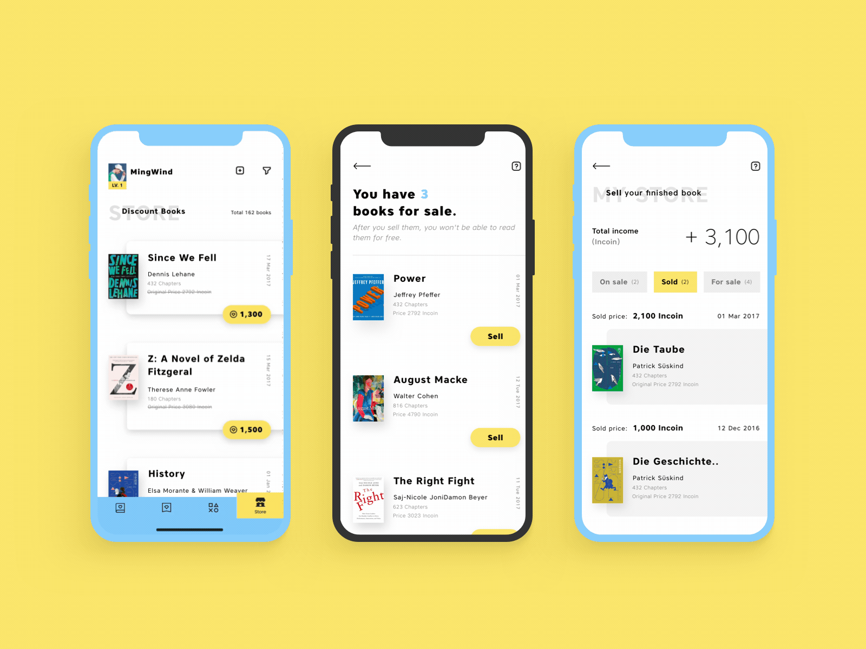

Slide 4

POLICIES
Registration is mandatory for buying or selling books.
Every you login to new device use same email address or password which you are enter while registering your self.
All your personal and transaction details are saved and can be changed easily
Used only secure network for maintain privacy

Slide 5
Features
Easy to buy or sell books(old or new) online
Donate your books
Voice search
Free to use
Mark your favourite books for future preference

Slide 6
Techonology
1. Hardware Requirement
- I3 processor system or higher
- 4 GB RAM or higher
- Android and iOS (Phone)
2. Software Requirement
- Windows 7 or higher
- Text Editor:- Sublime text
3. Language used
- React Native, firebase

Slide 7
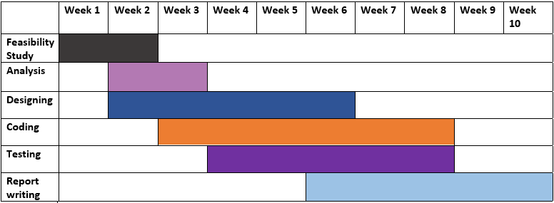
Gantt chat

Slide 8

Team Presentation
b
s
MADHUR MAHESHWARI TEAM LEADER
SAKSHI PANWAR
TEAM MEMBER
NISTHA GOYAL
TEAM MEMBER

Slide 9

Thank you!

Slide 10
Credits
Special thanks to all the team members and supervisior who gives their time and show potential for this work……

